Slide 1
Data Integrity 2
IN705 2018 Session 11.1

Slide 2
Locking Multiple Resources
Xact 1 | Time | Xact2
Read balance 1; sum = 40 | 1
Read balance2; sum = 90 | 2
 | 3 | Read balance 3 = 30
 | 4 | Decrement and write balance 3 -> 20
 | 5 | Read balance 1 = 40
 | 6 | Increment and write balance 1 -> 50
 | 7 | COMMIT
Read balance 3; sum = 110 | 8
Notes:
Often a transaction requires multiple fields to be read and written.
You have to be careful here, or you can introduce anomalies, even with locking
Recall this situation, where the total ends up wrong because T2 sneaks in and modifies balance2 after T1 has read it, but before T1 is finished with the calculation based on it.
Locking doesn’t resolve this, assuming that T1 doesn’t ask for the locks until right before he reads the values, and both transactions give up the lock on each object immediately after using it. In that case, the anomaly occurs just the same.
To prevent this, locks in a production database are generally allocated using a more elaborate protocol…

Slide 3
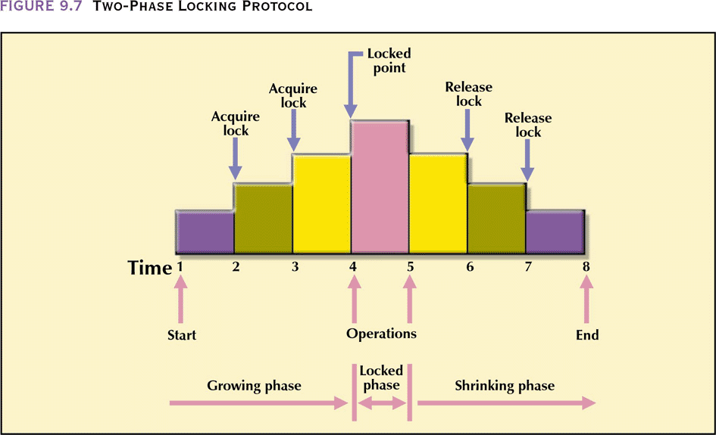
Two-Phase Locking
1) A transaction must acquire all the locks it needs before unlocking any object
2) Once a transaction gives up any of its locks, it may not acquire any further locks.
Notes:
The “two-phase” refers to the acquisition and release phases.
Note that the transaction doesn’t have to wait until it has all its locks to start working
It can get some locks, do what work it can, then get some more locks later
It just never releases any locks until the complete transaction is finished.
Therefore, no other transaction can ever see any of its objects in an intermediate state.
Thus if transaction T1 gets a lock needed by T2, T2 will not see any of the effects of T1 until T1 is completely finished
This is just as though T1 and T2 had run in serial.
Thus two-phase locking guarantees serialisability. There is always some sequence of serial execution to which the interleaved executions will be equivalent.
Specifically, transactions are serialised by the order in which they reach their lock points (proof available)
Unfortunately, two-phase locking is still susceptible to deadlock…

Slide 4
Locking Multiple Resources
Xact 1 | Time | Xact2
Read balance 1; sum = 40 | 1
Read balance2; sum = 90 | 2
 | 3 | Read balance 3 = 30
 | 4 | Decrement and write balance 3 -> 20
 | 5 | Read balance 1 = 40
 | 6 | Increment and write balance 1 -> 50
 | 7 | COMMIT
Read balance 3; sum = 110 | 8
Notes:
If we look at this transaction in a two-phase locking scenario, Transaction 1 holds on to the lock on balance 1 until it is finished, so Transaction 2 can cannot modify its value.
Step 5 cannot occur until step 8 has.
At the same time, Xact2 has balance 3 and won’t let it go, so step 8 cannot occur.
Deadlock
Can you think of a modification to the two-phase locking protocol that is immune to deadlock?
(Answer:
Require all transactions to request locks on objects in the same order, called “serialising the resources”.
Lots of overhead, and lots of wasted time.)
Mostly we do deadlock detection, rolling back one member of a deadlock cycle to break it.

Slide 5
Concurrency Protocol 2: Timestamp Ordering
Each transaction is given a “timestamp” when it initiates
Timestamps are unique and monotonic
For each data object, we store the timestamp of the transaction that most recently accessed it
Conflicts are identified by comparing timestamps
Notes:
No locks, so no waiting, and no deadlock
However, the timestamp ordering protocol relies heavily on restarting transactions that get into conflict.
Sometimes this is more costly than waiting and deadlock management
Date:
The basic idea is that if transaction A starts execution before transaction B, then the system should behave as if A actually executed in its entirety before B started (as in a genuine serial schedule). Thus A should never be allowed to see any of B’s updates; likewise, A should never be allowed to update anything that B has already seen [ because neither of these events could occur if A actually finished before B started]
[implemented as follows] For any given database request, compare the time stamp of the requesting transaction with the timestamp of the transaction that last retrieved or updated the requested object. If there is a conflict [i.e. one of the operations is/was a write] the requesting transaction is restarted with a new timestamp.

Slide 6
Timestamp Ordering
Assume T1 wishes to modify object X which was last modified by T2
If T1 younger than (i.e. started after) T2, T1 proceeds
It T1 is older than (i.e. started before T2), T1 restarts with a new timestamp.
Notes:
This means that either every action in TY will occur after every action in TO (same as if it was serial TO, TY)
Or TO has to start over
Thus TO never sees an intermediate state of TY.
Again, there are a number of extensions to this basic approach that improve performance through adding complexity.

Slide 7
Concurrency Protocol 3: Optimistic Methods
No locking or timestamping
Transactions run in three phases:
Read:
All values are grabbed and computations done
Results saved in a private copy
Validate:
System determines if computations contained a conflict anomaly
If no anomaly, results are committed. If anomaly, transaction is restarted.
Notes:
The optimistic methods are a set of protocols that assume that, really, resource conflicts (RW, WR or WW) don’t occur that often
So the anomalies don’t occur that often
So, why worry about it.
The algorithms for determining if an anomaly occurred are complex and involve computing the dependencies of the set of active data objects.
This is still often more efficient than managing a 2PL or timestamp locking system
The optimistic approach actually works quite well in databases that are read-heavy.

Slide 8
What Is Locked?
Database
Table
Disk page
Row (record)
Field
Complex
Restrictive
Notes:
Throughout this discussion we have talked about locking “database objects”, and our examples have made it look as though locks were applied at the individual field level.
This is not actually true.
The overhead for that in a large database would be too much
Thus, one of the choices we make in DBMS design is the “granularity” of lock
Given what we know about the physical implementation of databases, we could lock at any of these levels.
(E.G. if we lock at the table level, any requests for data from the same table – even different records – are in conflict)
We balance the complexity of the management against the restrictiveness
What would you predict is the most popular locking granularity? (Disk page)
This combines the most efficient hardware protocol with an intermediate state on each of the competing criteria of efficiency and flexibility

Slide 9
Disaster Recovery
Backup :
Makes periodic snapshots of all or part of the database
Journaling :
Makes an audit trail of transactions
Checkpoint:
Periodically halts transactions and synchronises all files and journals
Recovery:
Recreates the database in event of corruption or loss
Notes:
Even if you get your concurrency working perfectly so that transactions don’t corrupt the data, bad things can happen
Your server can melt or get a virus; your building can burn down.
Recall that one of the requirements of transactions is that they be Durable. That is, once committed they stay forever.
So we must be able to get that database back if something catastrophic occurs
To simplify, this is managed by basically backing everything up – not just the contents of the database, but also a record of what things have been done to the database.
At the facilities level, a DBMS usually provides these four: (journaling also called journalizing)
Backup and checkpoint are just what they sound like.
The DBMS provides tools for scheduling them. You will cover this in the DBA practicals.
The interesting one is Journalizing

Slide 10
Disaster Recovery
Journaling
Records information about all transactions since latest backup
In event of failure, transactions can be rerun from latest backup state

Slide 11
Transaction Log
When any transaction causes data modification, the change is first recorded in a special system file.
Only after the transaction terminates successfully are the changes made to the actual database
The transaction log thus:
supports data integrity
makes possible database recovery
Notes:
Whenever a user writes or edits data, SQL Server first records the change
Log records either store the instructions performed, or the store before/after snapshots of the state of the data
Thus “rolling back” is really implemented by “not writing the changes out, and marking this as rolled back in the transaction log”
Can you think of any disadvantages associated with maintenance of transaction logs? (Time and space)
Can you think of any way this approach could fail? (If the logs become corrupted. So they need backed up too)

Slide 12
SQL Server Terminology
Dirty read
Read something that gets rolled back
Nonrepeatable read
Read something that gets updated, then read again
Phantom read
Read before and after an insert that expands the set of keys that match the query parameters

Slide 13
SQL Server Isolation Levels
READ UNCOMMITTED
READ COMMITTED (default)
REPEATABLE READ
SERIALIZABLE
SNAPSHOT
READ COMMITTED SNAPSHOT
Notes:
SQL Server always gets an exclusive lock for writing (always)
Isolation levels are controlled by how long you hold a shared lock for
READ UNCOMITTED for bulk operations etc – don’t even ask for shared locks
READ COMMITTED get shared lock, but release it as soon as you’re done with the resource
REPEATABLE READ get shared lock and hold it until the end of the transaction
SERIALIZABLE get shared lock until end of transaction AND lock the whole range of keys that satisfy query
SNAPSHOT alter database to allow multi-versions to be stored in tempdb; behaves like row-versioned SERIALIZABLE
READ COMMITTED SNAPSHOT alter database my_db SET READ_COMMITTED_SNAPSHOT ON; --This actually changes the default from “READ COMMITTED”, behaves like row-versioned READ COMMITTED

Slide 14
Great Reads
https://www.red-gate.com/simple-talk/sql/t-sql-programming/questions-about-t-sql-transaction-isolation-levels-you-were-too-shy-to-ask/
https://www.sqlskills.com/blogs/paul/a-sql-server-dba-myth-a-day-2630-nested-transactions-are-real/

